Slide 1
Title of the Initiative
Content Development for “Orientation Training Program on Maharashtra Right to Public Services (MRTPS) Act -2015” for Implementation in Campaign Mode
Wel-Come
Thematic Track
Development of Training Content
Presentation BY: Pradip Garole
Director,
State Training Planning & Evaluation Agency,
Yashwantrao Chavan Academy of Development Administration, (YASHADA), Pune, (Maharashtra)

Slide 2
Background
Government of Maharashtra (GoM) approved the State Training Policy (STP) on 9th September 2011
As per the STP, we have to organize “Orientation Training” programs after every prominent change in the Policy, Technology & Organizational things
Maharashtra Right to Public Services Act 2015 signed by Honorable Governor of Maharashtra on 19th August & published on 21st August 2015.
As MRTPS Act-20015 is a policy related change, we decided to organize Orientation Training on the same
Aim of the Training : To enable the Government Machinery to provide transparent, efficient and timely public services to the eligible persons in the state of Maharashtra.

Slide 3
Important Features of Act
As per the MRTPS Act every Public & Local Authority has –
To notify their services, declare Stipulated time limit, Prescribed application form, Fees (If any) & Documents to be submitted etc.
To display the list of Designated officers, First & Second Appellate Authority, Penalty, Procedure for recovery of penalty, fixing responsibility for repeated failure on the part of the employees & action against applicant providing false information.
To provide receipt of application mentioning date, place, Stipulated time limit & “Unique Application Number” on it (so that applicant can monitor the status of application in person/ on-line).
To provide on-line services in near future.

Slide 4
Content & Trainer Development
Taking into account extent, time limit, resources etc. STPEA, YASHADA carried out Pre- training activities, such as -
Identified Training Needs, developed Design & Plan,
Prepared PPTs, identified related Documentaries & Films
Prepared Reading Material, Process Sheet, Frequently Asked Questions (FAQs) & Model Questions Papers
Collected the Departments’ Notifications of respective services.
STPEA & RTI Center of YASHADA & Experts / Visiting Faculties validated the Pre- training activities in the Validation Workshop
One lakh copies of Reading material got printed, out of which 90,000 copies & other related material also dispatched to District ATIs by STPEA, YASHADA
ToTs (State level) – Organized & developed
ToTs (District level) - Organized & developed

Slide 5
Co-ordination & Monitoring of Program
GAD issued necessary GRs/ Circulars which provided well designed policy framework
STPEA, YASHADA Implemented & Monitored the Program.
Guardian Officers of YASHADA co-ordinated with the District Collectors & District ATIs from YASHADA level with regard to Preparatory arrangements including nominations of participants of various departments.
Nominations to Training & Effective supervision done by the respective District Collectors.
Committed efforts from District ATIs with regard to Training.

Slide 6
Content development for Orientation Training on MRTPS Act for implementation in Campaign Mode: By YASHADA, Pune
Sr.No | Date | Activities
1 | 21ST August 2015 | MRTPS Act -2015 Published
2 | 22nd September 2015 | Meeting at Mumbai to decide the strategy.
3 | 23rd to 29th September 2015 | TNA, Design, PPTs, Process Sheet, Collection of Notifications, FAQs, Question Papers, Reading Material (One lakh Copies)
4 | 30th September 2015 | 1st State Level ToT at YASHADA (55 Trainers)
5 | 5th October 2015 | 2nd State Level ToT at YASHADA (75 Trainers)
6 | 6th to 8th October 2015 | 36 District Level ToTs ( Trainers developed 2815)
7 | 15th to 31st October 2015 | Phase-I, (Participants Trained 28733)
8 | 11th November to 5th December 2015 | Phase-II, (Participants Trained 52779)
 |  | Total Trainers & Participants Trained = 84,457

Slide 7
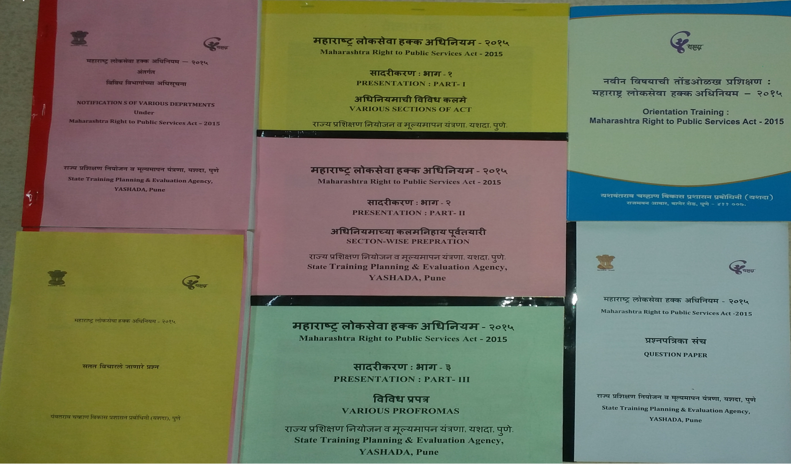
Content Developed for the Training

Slide 8
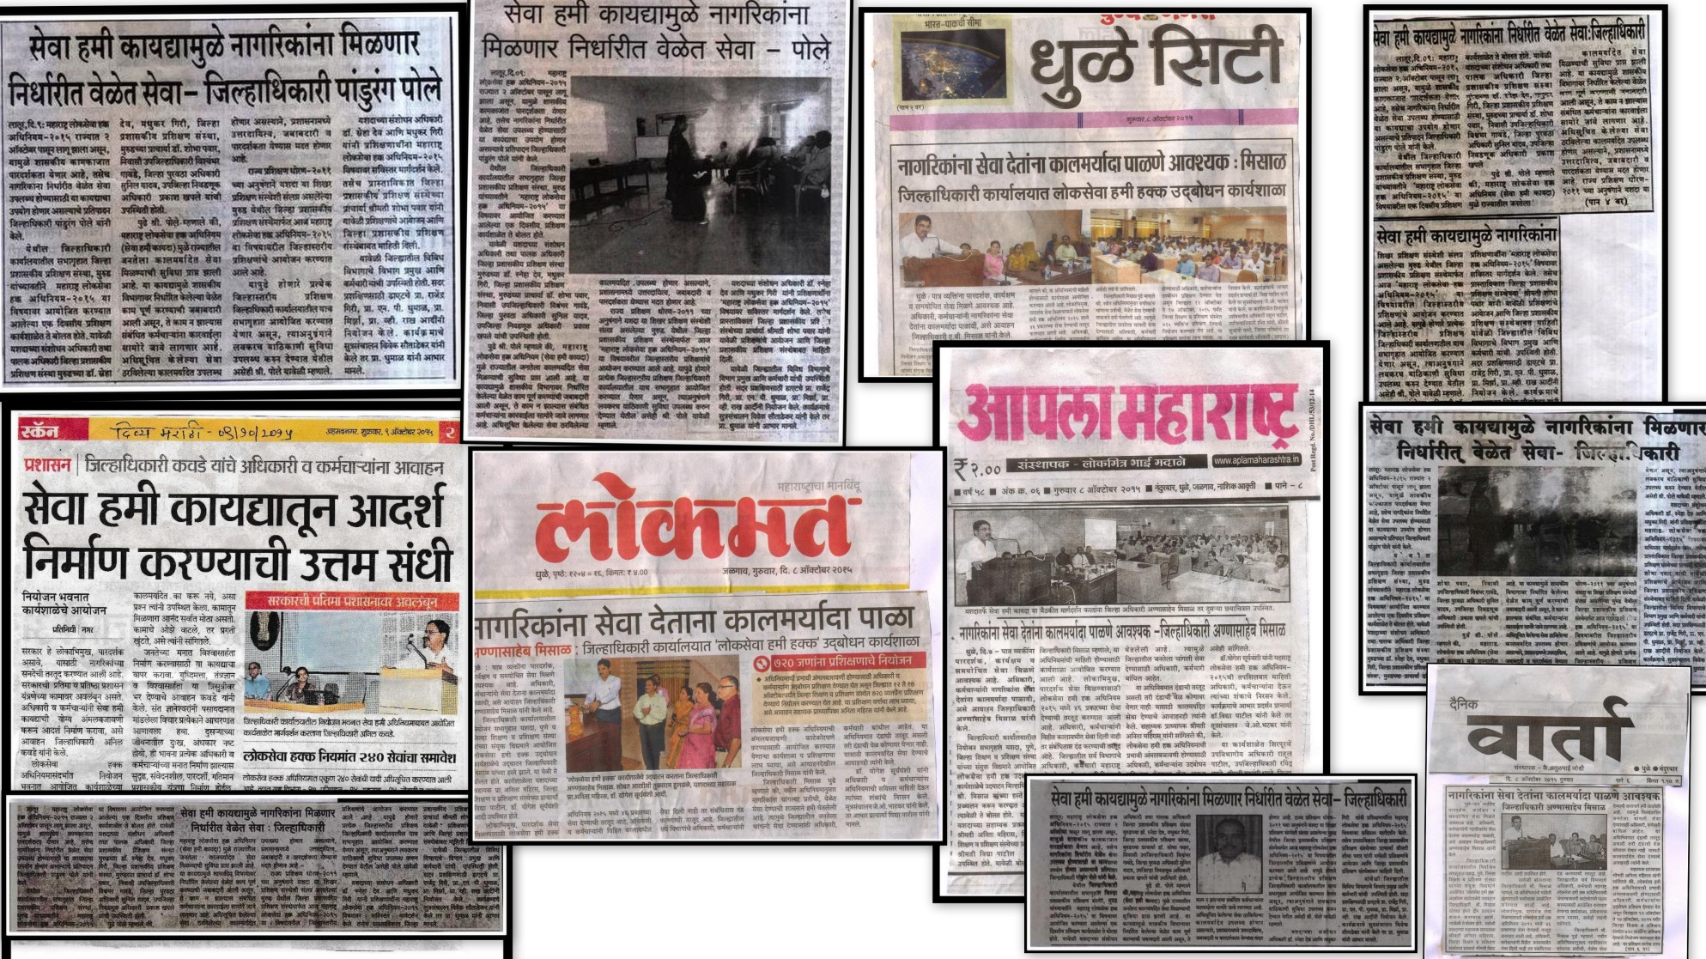
News Paper Cuttings

Slide 9
Impact
Sr. No. | Impact Indicators | Before Training | After Training
1 | Number of department Providing On-line Services | 5 | 22
2 | On-line Services Offered | 46 | 156

Slide 10

Thanks!

